Slide 1

Optimize - Azure Synapse SQL Pool
{ |  | }
 | Optimize Azure Synapse SQL Pool
DXC Technology

Slide 2

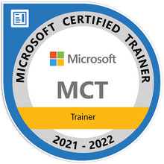

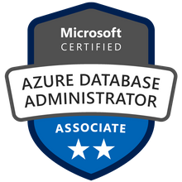

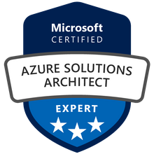

John Deardurff
Microsoft Customer Engineer (Global Technical Team)
Microsoft Certified Trainer (Regional Lead)
MVP: Data Platform (2016 – 2018)
Email: John.Deardurff@Microsoft.com
Twitter: @SQLMCT
Website: www.SQLMCT.com
GitHub: github.com\SQLMCT
Notes:
While all this has been running, several other parts of SQLOS have been active:
Monitoring: DMVs, Extended Events (xEvents), and so on.
Deadlock Monitor thread: Monitors for and deals with deadlocks.
Lazy Writer threads: Clock sweeping the buffer pool to maintain the free lists and responsible for writing dirty pages to disk between checkpoints.
Scheduler Monitor thread: Monitors scheduler health and detects issues such as non-yielding scenarios.
Resource Monitor thread: Monitors available memory from operating system and internal to SQL Server and notifies the Clerks.
The Hosting APIs for external components interface with Microsoft Data Access Components (MDAC) and common language runtime (CLR).
The Storage Engine manages all data access, both through transaction-based commands (with the Transaction Manager) and bulk operations such as backup, bulk insert, and certain Database Console Command (DBCC) commands.
Access Methods is an important component of the Storage Engine, and contains components to open a table, retrieve qualified data, and update data.
The Access Methods code does not actually retrieve the pages, it will make a request to the Buffer Manager, which holds a copy of the requested data pages in memory (and if the requested page is not in memory, it will retrieve it from disk). By memory, we mean specifically the Buffer Pool, which is part of the SQLOS.
The Transaction Manager ensures that transactions adhere to the ACID properties: atomicity, consistency, isolation, and durability.
It also outlines the boundaries of statements that must be grouped together to form an operation, and it allows “nested” transactions by managing savepoints, if any. Furthermore, it also coordinates with the Lock Manager regarding when locks can be released, based on the isolation level in effect. It also coordinates with Access Methods to determine when old versions of rows are no longer needed and can be removed from the version store.
The File Manager handles actual physical access to data and log files, as well as access to backup devices.
Also included in the storage engine are components for controlling utilities such as Bulk Load, DBCC commands, and Backup/Restore operations.
The SQLOS layer handles activities that are normally considered to be operating system-like responsibilities, such as Thread Scheduling, Synchronization services (latching and deadlock detection), Memory management (including the Buffer Pool), Lock management, I/O management (which establish the completion routines for read/write operations from memory to disk and vice-versa) , and Monitoring (such as DMVs and xEvents).
Locking is a crucial function of a multi-user Remote Desktop Management Services (RDMS) such as SQL Server, even if you are operating an optimistic concurrency model such as snapshot isolation level, to help ensure the isolation and consistency properties of ACID. This is handled by the Lock Manager, whose main job is to provide hierarchical access to data in a concurrent fashion (as allowed by the Isolation Level of the transaction), by managing compatibility between the lock types. It also resolves deadlocks (with the aid of the Deadlock Monitor thread), and escalates locks if needed. Other components such as the other threads in the figure will be explained in an upcoming lesson in this module.

Slide 3
Optimize Azure Synapse SQL Pool Engagement Overview
Introduction
The Optimize Azure Synapse SQL Pools engagement provides attendees with the knowledge and understanding of how queries are processed in SQL pools and how to optimize workloads for performance.
Scope
In scope:
Standalone Azure Synapse provisioned SQL Pools
Out of scope:
Azure Synapse Serverless SQL Pools
While we may address certain issues during the engagement, the goal is not to fix specific queries, rather the goal is to provide the knowledge needed to identify and optimize query and workload issues.
Expectations
SQL Pools provisioned via Synapse Workspaces

Slide 4
Optimize Azure Synapse SQL Pool Engagement Goals
Tools provided to use for optimizing workloads:
We will configure monitoring via Azure Dashboards and Log analytics for continued monitoring.
A set of SQL queries useful in identifying problem queries
A set of log analytics queries useful in identifying workload issues
Knowledge on how to configure alerts for certain workload issues

Slide 5
Phases for Optimize Azure Synapse SQL Pool Engagement
Phase II – Knowledge Transfer
Phase I – Data Gathering
Phase III – Hands on Troubleshooting

Slide 6
Phase I – Data Gathering
The Friday prior to the engagement, the PTO accredited engineer will work with the customer to select 3 to 5 queries from the customer environment for the hands-on review.
We will need someone in the class with:
Access to the azure portal to run log queries and create dashboards
Access with SSMS and Visual Studio (SSDT) to query the SQL Pool.
Is there an Azure Synapse environment available?
Specific-Query Troubleshooting
Workload usage review and issue discovery
Possible Scenarios to review:

Slide 7

Knowledge Transfer (Minutes)
Module 1 - Introduction (60)
Module 2 - Table Design (180)
Module 3 - Indexing (60)
Module 4 - Database Scaling (60)
Module 5 - Data Loading (45)
Module 6 - Cache Management (60)
Module 7 - Workload Management (60)
Module 8 - Execution Plans (60)
Module 9 - Statistics (45)
Module 10 - Data Movement (45)
Module 12 - Workload Monitoring & Optimization (30)
Module 11 - Query Optimization (30)

Slide 8
Phase III
Phase III – Hands on Troubleshooting
The latter half of day three will be spent reviewing the selected queries through an interactive troubleshooting session. A member of the customer team will navigate, and the PTO engineer will explain their reasoning as they work through the troubleshooting and optimization process.
This session is intended to be highly interactive, and customer team members are highly encouraged to ask questions or make suggestions during the optimization process.

Slide 9

Attendee Introductions
Name
Job/Team/Specialty
Time Zone
Experience
Expectations

Slide 10
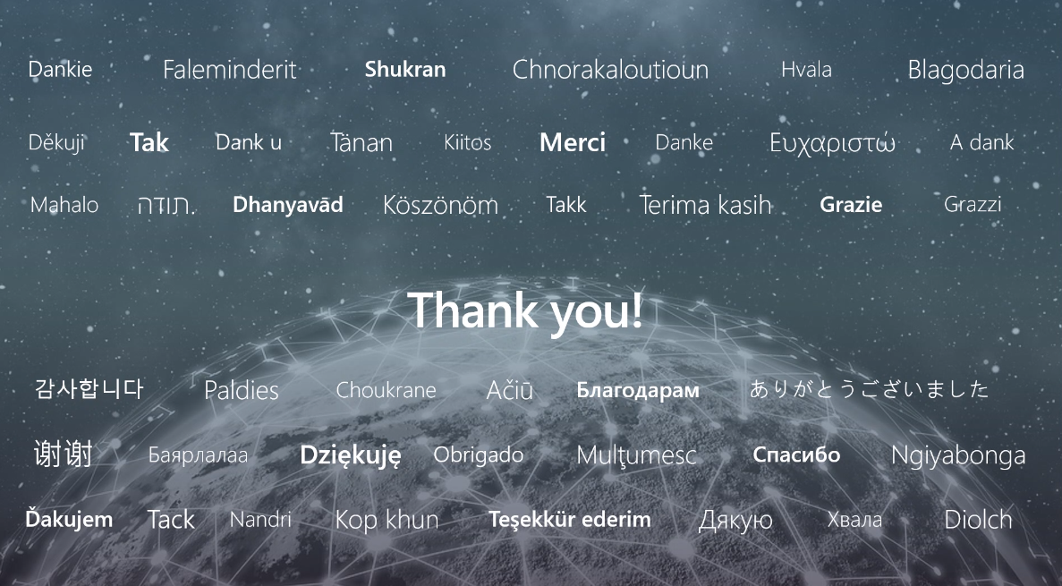

Slide 11
Microsoft

